Slide 1
While loop

Slide 2
Index
INTRODUCTION TO C 3
BASIC TERMINOLOGIES 4
WHILE LOOP 5
NADIA PROGRAM 6
CONCLUSION 11

Slide 3
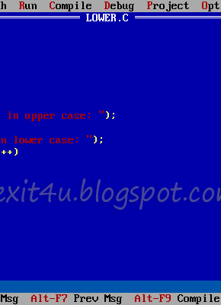
What is C?
C language is a high-level programming language developed in the early 1970s by Dennis Ritchie at Bell Labs. It was created to develop the UNIX operating system and has since become one of the most widely used programming languages in the world.
Here’s a brief explanation:
🧠 Type: Structured, procedural programming language.
⚙️ Purpose: System programming (like operating systems, compilers) and application development.
💻 Features:
Fast and efficient — close to machine language.
Portable — can run on different hardware with little change.
Uses functions to organize code.
Allows low-level memory access using pointers.
Supports modular programming (breaking code into small parts).
This Photo by Unknown Author is licensed under CC BY-NC-ND

Slide 4
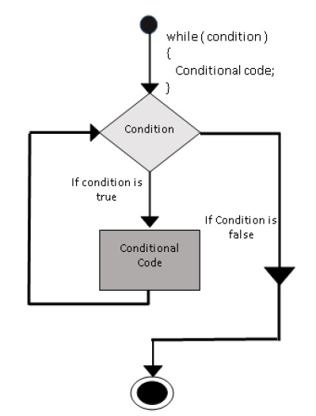
Loop & While Loop
A loop in C is used to repeat a block of code multiple times until a certain condition is met. It helps avoid writing the same code again and again.
Types of loops in C:
for loop – repeats a block a specific number of times.
while loop – repeats while condition is true.
do...while loop – executes the code once, then checks the condition.
This Photo by Unknown Author is licensed under CC BY-SA

Slide 5
While Loop
A while loop is used to repeat a block of code as long as a given condition is true. It is also called a pre-test loop, because the condition is checked before the loop runs each time.
Syntax:
while (condition) {
// statements to execute
}
condition: An expression that is tested before each loop iteration.
If the condition is true, the loop runs.
If the condition becomes false, the loop stops.

Slide 6
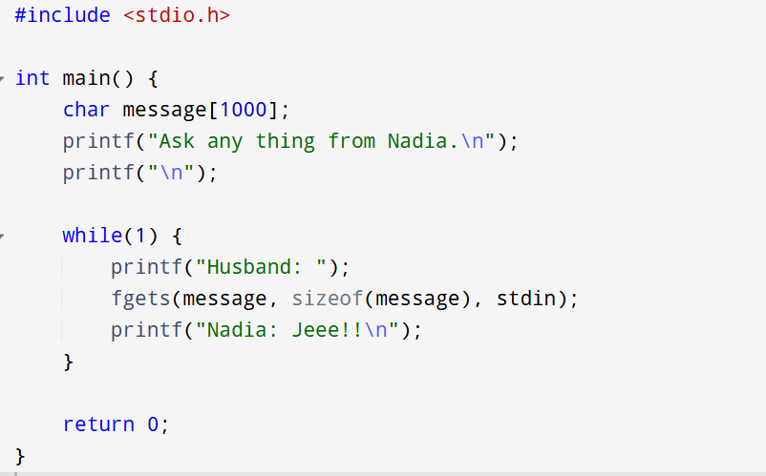
Nadia Program
Q1) Why Include <stdio.h> ?
Think of your program as your school bag 🎒
header files (like <stdio.h>) as the books you put inside.
You don’t carry every book you own every day, right? You only pack the ones you need for today’s class otherwise, your bag will be too heavy!
So when you write:
#include <stdio.h>
you’re basically saying:
“I’m only taking my Input-Output book today because I’ll need to use printf() and fgets() in class.”
If you forget the book (#include <stdio.h>),
the teacher (compiler) will say:
“Hey! You didn’t bring your I/O book! You can’t use printf()!”

Slide 7
Q1) Why Include int main ?
int main() { ... }
Every C program starts execution from the main() function.
int means that this function will return an integer value to the system when it finishes.
📘 In short: main() is the entry point of every C program.

Slide 8
char message[1000];
This creates a character array (also known as a string) named message.
It can store up to 1000 characters.
This is where the user’s input (the husband’s question) will be saved.
📘 In short: message stores whatever text the user types.

Slide 9
While Loop
while(1) { ... }
This is a while loop that will run forever.
The condition (1) is always true, so the loop never ends.
Such a loop is called an infinite loop — useful for continuous interaction or programs that should run until stopped manually.

Slide 10
F gets and why not scanf
Feature | scanf() | fgets()
Spaces | ❌ Stops reading when it sees a space. Example: typing Hello world → only reads Hello. | ✅ Reads the whole line including spaces. Hello world stays exactly that.
Safety | ⚠️ Can cause buffer overflow if user types too much. | ✅ Safer — it knows the maximum size of the variable.
Leftover input | 😬 Often leaves \n or extra input in the buffer, causing weird bugs. | 😊 Handles newline properly (adds \n at the end).
Use case | Best for numbers or single words. | Best for full sentences or text lines.

Slide 11
Conclusion
Starts with #include <stdio.h> – includes the Input/Output library, just like packing the book you need for today’s “class.”
int main() – the program’s main function, where execution begins.
char message[1000]; – a large string to store whatever the user types.
printf() statements – display messages on the screen.
while(1) loop – creates an infinite conversation (runs forever).
fgets() – safely reads full user input (including spaces).
printf("Nadia: Jeee!!") – prints a fixed response each time.
return 0; – ends the program properly when stopped.

Slide 12
Any Questions If Yes Ask ChatGPT

Slide 13
thank you
M rehan
25f cy 102

